Slide 1

Executive Summary

Slide 2






Data Summary
Prepared and made available by Davide Anguita, et al. from the University of Genova, Italy and is described in full in their 2013 paper “A Public Domain Dataset for Human Activity Recognition Using Smartphones.”
30 subjects aged between 19 and 48 years old
Performing one of 6 standard activities while wearing a waist-mounted smartphone (Walking, Walking Upstairs, Walking Downstairs, Sitting, Standing, Laying)
Data was labeled manually from recorded videos
Movement data recorded was the x, y, and z accelerometer data (linear acceleration) and gyroscopic data (angular velocity) from the waist-mounted Samsung Galaxy II - 50 Hz

Slide 3
Data Summary
The dataset is partially preprocessed (noise filters, fixed windows of 2.56 seconds (128 data points) with 50% overlap, splitting of accelerometer data into gravitational (total) and body motion components)
Split into train (70%) and test (30%) → 21 subjects for train and nine for test.

Slide 4
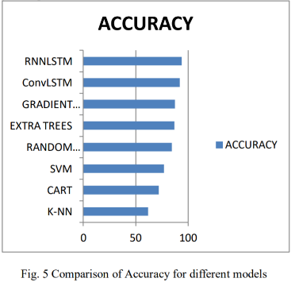
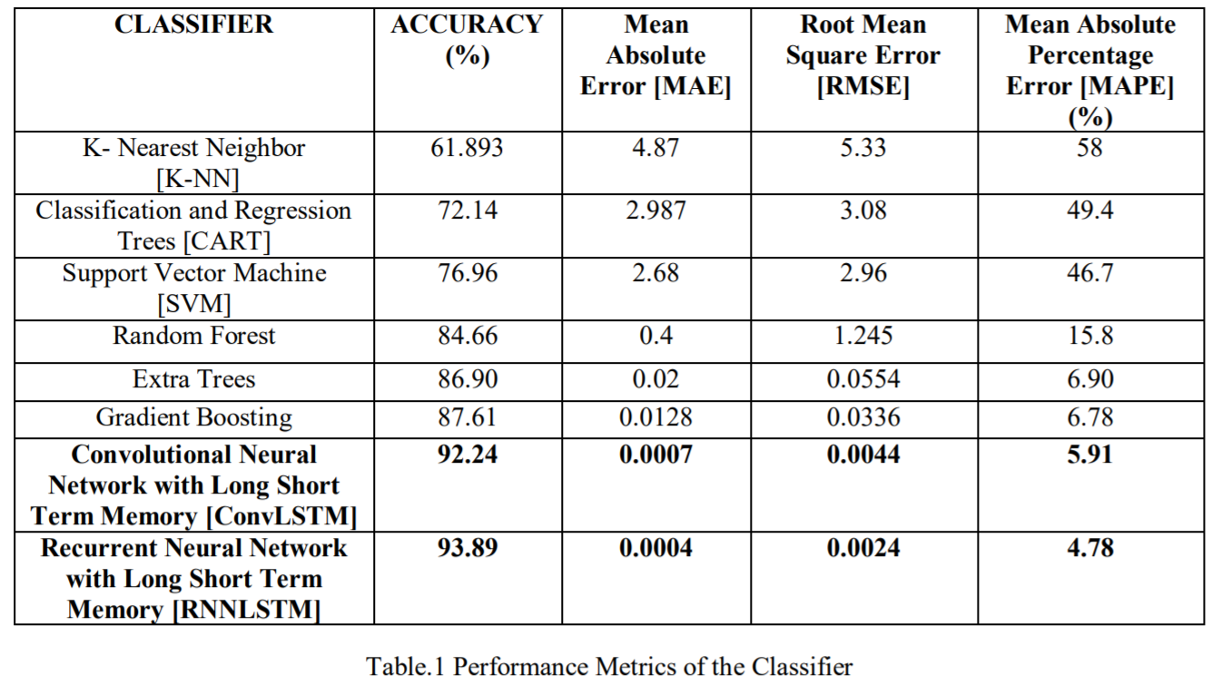
Literature
Source: Chen, Zhenghua & Jiang, Chaoyang & Xiang, Shili & Ding, Jie & Wu, Min & li, Xiaoli. (2019). Smartphone Sensor Based Human Activity Recognition Using Feature Fusion and Maximum Full A Posteriori. IEEE Transactions on Instrumentation and Measurement. PP. 1-1. 10.1109/TIM.2019.2945467.
Other papers also show good results (Precision 89%) by applying Support Vector Machine (SVM) learning algorithms
(Anguita, D., Ghio, A., Oneto, L., Parra, X., & Reyes-Ortiz, J.L. (2013). Energy Efficient Smartphone-Based Activity Recognition using Fixed-Point Arithmetic. J. Univers. Comput. Sci., 19, 1295-1314.
Anguita, Davide & Ghio, Alessandro & Oneto, Luca & Parra, Xavier & Reyes-Ortiz, J. (2012). Human Activity Recognition on Smartphones for Mobile Context Awareness. )

Slide 5

Process going forward
Data Loading
Model Building
Assessment and Selection
Further Processing

Slide 6

Tools
GitHub
DeepNote vs Google Colab
Should we stick to Pytorch?

